Slide 1

Customer Shopping Behavior Analysis
This project analyzes customer shopping behavior using transactional data from 3,900 purchases to uncover insights into spending patterns, customer segments, product preferences, and subscription behavior.

Slide 2

Project Overview & Dataset Summary
Project Goal
Uncover insights from 3,900 purchases to guide strategic business decisions.
Key Features
Customer demographics (Age, Gender, Location, Subscription)
Purchase details (Item, Category, Amount, Season, Size, Color)
Shopping behavior (Discount, Promo, Previous Purchases, Frequency, Review, Shipping)
Dataset Snapshot
Rows: 3,900
Columns: 18
Missing Data: 37 values in Review Rating

Slide 3
Exploratory Data Analysis with Python
Data Loading & Exploration
Missing Data Handling
Column Standardization
Imputed `Review Rating` null values using median per product category.
Imported dataset with `pandas`, checked structure and summary statistics.
Renamed columns to `snake_case` for readability.
Feature Engineering
Database Integration
Created `age_group` and `purchase_frequency_days` columns.
Loaded cleaned data into PostgreSQL for SQL analysis.

Slide 4
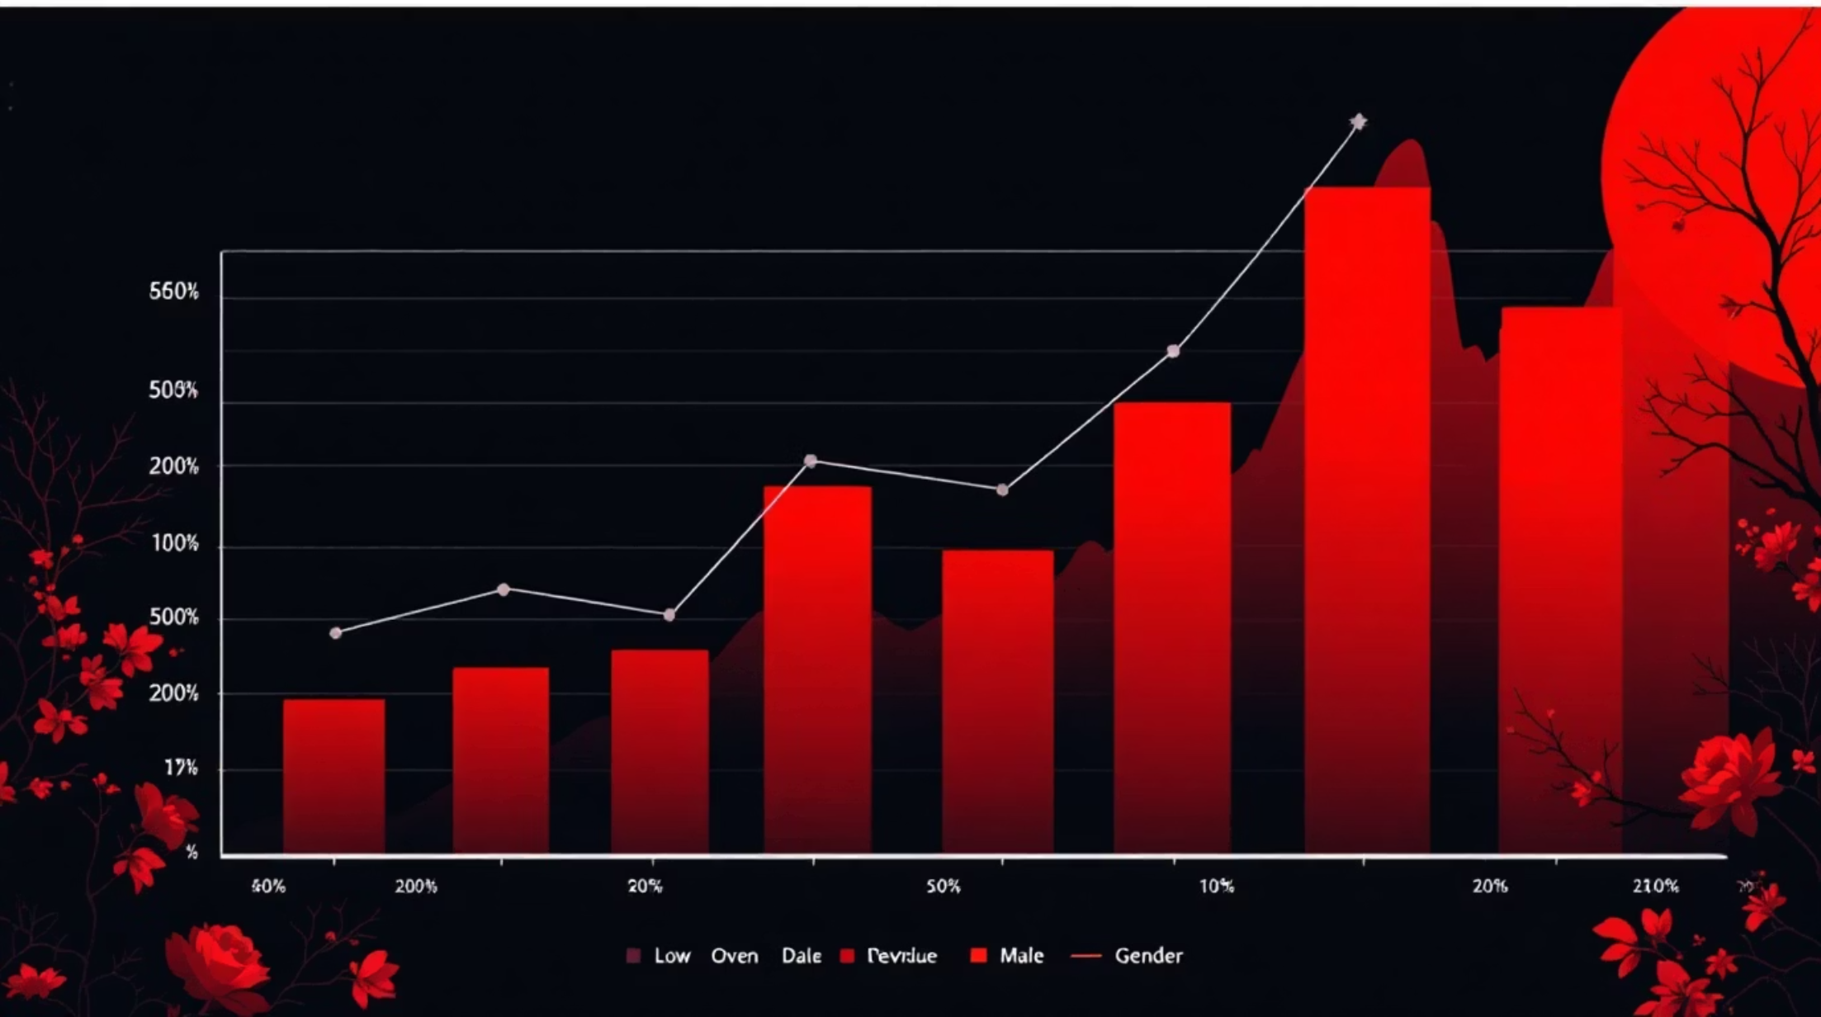
SQL Analysis: Revenue & Discounts
High-Spending Discount Users
Identified 839 customers who used discounts but still spent above the average.
Revenue by Gender
Male customers generated significantly more revenue.
Gender
Revenue
Female
75,191
Male
157,890

Slide 5

SQL Analysis: Product Insights
Top 5 Products by Rating
Item Purchased
Avg. Rating
Gloves
3.86
Sandals
3.84
Boots
3.82
Hat
3.80
Skirt
3.78
Discount-Dependent Products
"Hat" and "Sneakers" had the highest percentage of discounted purchases.
Item Purchased
Discount Rate
Hat
50.00%
Sneakers
49.66%

Slide 6

SQL Analysis: Shipping & Subscriptions
Shipping Type Comparison
Express shipping users had a slightly higher average purchase amount.
Shipping Type
Avg. Purchase
Standard
58.46
Express
60.48
Subscribers vs. Non-Subscribers
Non-subscribers represent a larger customer base and higher total revenue.
Status
Customers
Avg. Spend
Total Revenue
Yes
1053
59.49
62,645
No
2847
59.87
170,436

Slide 7
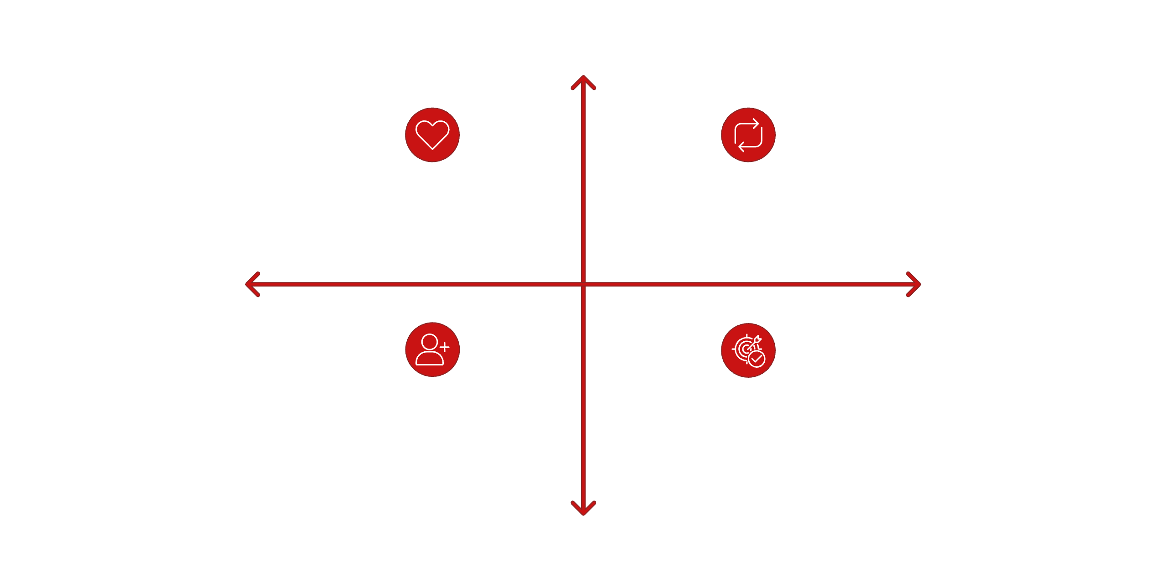




SQL Analysis: Customer Segmentation
High Retention
High Value Loyal — 3,116 customers
Growing Returning — 701 customers
Low Revenue
High Revenue
Low Volume New — 83 customers
Opportunity Segment — Target for growth
Low Retention
Customers were segmented based on purchase history, revealing a large loyal base and opportunities for new and returning customer engagement.
Customer Segment
Number of Customers
Loyal
3116
New
83
Returning
701

Slide 8

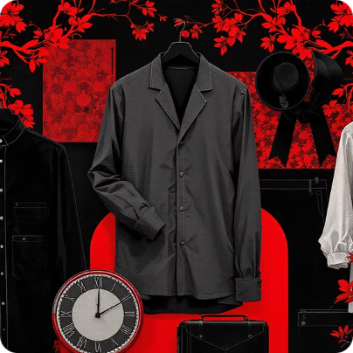

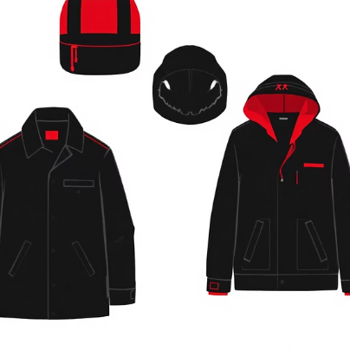
SQL Analysis: Top Products per Category
Accessories
Clothing
Footwear
Outerwear
Jewelry (171 orders)
Sunglasses (161 orders)
Belt (161 orders)
Blouse (171 orders)
Pants (171 orders)
Shirt (169 orders)
Sandals (160 orders)
Shoes (150 orders)
Sneakers (145 orders)
Jacket (163 orders)
Coat (161 orders)

Slide 9
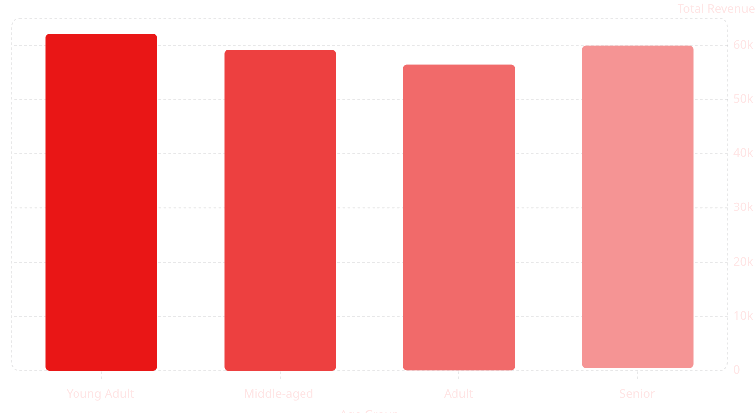
Key Metrics & Revenue by Age Group
Key Metrics
Number of Customers: 3.9K
Average Purchase Amount: $59.76
Average Review Rating: 3.75
Repeat Buyers & Subscriptions
Most repeat buyers (over 5 purchases) are not subscribed, indicating a potential for conversion.
Subscription Status
Repeat Buyers
Young Adults contribute the highest revenue, followed closely by Middle-aged customers.
No
2518
Yes
958

Slide 10
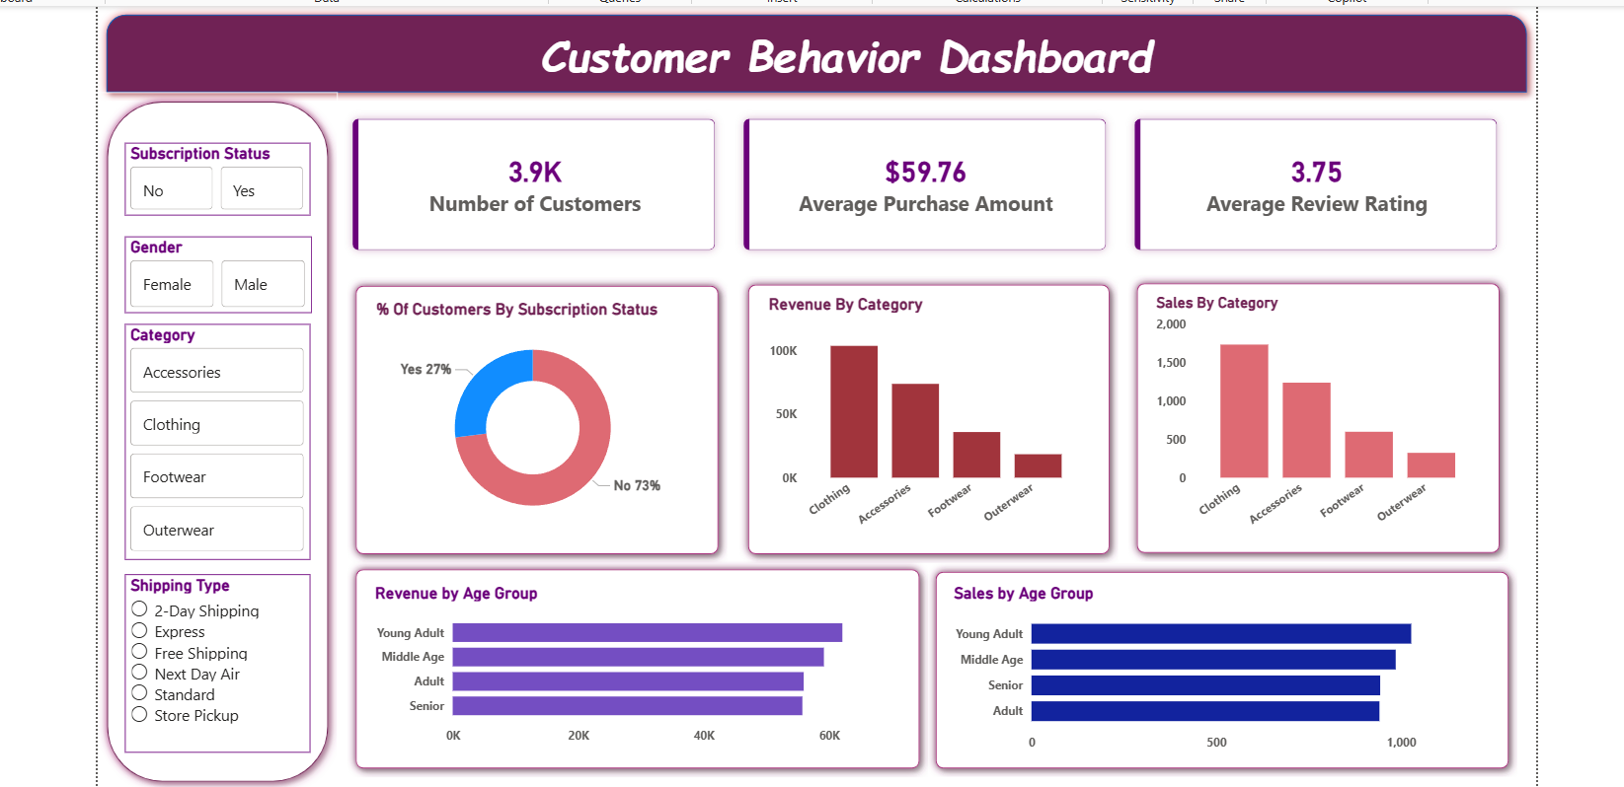
Business Recommendations
Boost Subscriptions
Customer Loyalty Programs
Review Discount Policy
Promote exclusive benefits to increase subscriber base.
Optimize discounts to balance sales and profit margins.
Reward repeat buyers to foster loyalty and retention.
Product Positioning
Targeted Marketing
Highlight top-rated and best-selling products in marketing.
Focus efforts on high-revenue age groups and express shipping users.

